Slide 1





Design of Smart Medical Assistant Robot for Contactless Preliminary Health Checkup of COVID Patients
Group Members
a
a
v
-
ir
-
a
-

Slide 2


ABSTRACT

The preliminary health tests of patients in the hospital are carried out by doctors. This requires them to be in contact with the patient which may unknowingly expose them to contagious diseases and it wastes their invaluable time for tests which are primitive in nature. This also increases the waiting time of other patients in the hospital and these lead times can stack up to delay urgent medical treatment of the patients with severe illness. The present guidelines of the World Health Organization amidst the ongoing pandemic of COVID-19 strongly suggest social distancing among humans to curtail the spread of the novel coronavirus.

Slide 3
Outlines

➢
➢
➢
➢
➢
➢
➢
➢
➢
➢
Introduction
Existing System
Drawbacks
Main Objectives
Modules
Block Diagram
Working of system
Advantages
Conclusion
Future Scope

Slide 4
INTRODUCTION

The project aims to provide a contactless testing method to the doctors in hospitals to conduct initial health checkups like measuring the body temperature of the patients, their heart rate, pulse rate and oxygen levels. This paper was conceived as a result of the observations made during the ongoing pandemic of COVID-19, wherein the doctors are having to be in contact with the patients in order to test and treat them, thereby increasing the risk of a community spread. The robot contains sensors like Oximeter MAX 30105 to measure the blood oxygen saturation and heart rate of the patients as a preliminary test criteria.

Slide 5
EXISTING SYSTEM

Doctors need to regularly monitor patient health.
The doctors are at risk of infection just for monitoring purpose.

Slide 6
DRAWBACKS IN EXISTING SYSTEM

➢ The systems are not Portable.
➢ The patient cant able to understand the analog signals.
➢ Complex system and difficult to operate.

Slide 7
MAIN OBJECTIVE

To Solve this issue we here design a remote IOT based health monitor system that allows for remptely monitoring of multiple covid patients over the internet.
This system is to be available at reasonable prices.
The system then transmits this data over the internet using wifi transmission by connecting to wifi internet connection.

Slide 8
PROPOSED METHOD

➢ A Wi-Fi
based
Design of Smart Medical Assistant Robot
system is used.
➢ Mainly three parts of the system,
Heartbeat & Spo2
temperature sensor, transmitter and receiver.
➢ Hear beat sensor is used to measure heart beat rate of the patient.
➢ Temperature sensor is used to measure body temperature.

Slide 9

transmitter transmits the heart beat count and
➢ The
temperature of patient.
➢ Data transmitted Via IoT server.
➢ Transmitter is placed near the patient.

Slide 10

➢ Receiver receives the data.
➢
Receiver is placed at the doctor’s side.

Slide 11
MODULES

➢ An Embedded technology is used here.
➢ Atmel Arduino UNO is used in this system.
➢ Wi-Fi used for transmitting data.

Slide 12
BLOCK DIAGRAM OF THE SYSTEM


Slide 13
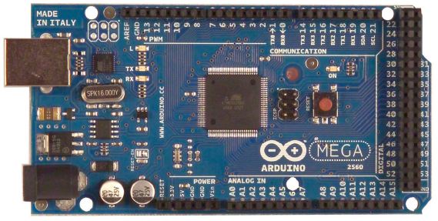
Arduino MEGA
The Arduino Mega 2560 is a microcontroller board based on the ATmega2560 (datasheet). It has 54 digital input/output pins (of which 14 can be used as PWM outputs), 16 analog inputs, 4 UARTs (hardware serial ports), a 16 MHz crystal oscillator, a USB connection, a power jack, an ICSP header, and a reset button. It contains everything needed to support the microcontroller; simply connect it to a computer with a USB cable or power it with a AC-to-DC adapter or battery to get started.

Slide 14
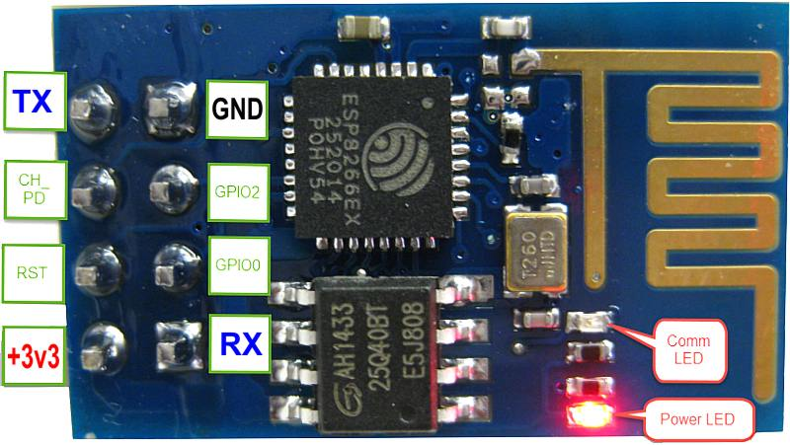
Wi-Fi ESP8266:
ESP8266 offers a complete and self-contained Wi-Fi networking solution, allowing it to either host the application or to offload all Wi-Fi networking functions from another application processor.
When ESP8266 hosts the application, and when it is the only application processor in the device, it is able to boot up directly from an external flash. It has integrated cache to improve the performance of the system in such applications, and to minimize the memory requirements.

Slide 15
Power supply
The microcontroller and other devices get power supply from AC to Dc adapter through voltage regulator. The adapter output voltage will be 12V DC non-regulated. The 7805 voltage regulators are used to convert 12 V to 5VDC.
AC Power
AC/DC Adapter
Regulator (7805)
Filter
DC Output

Slide 16
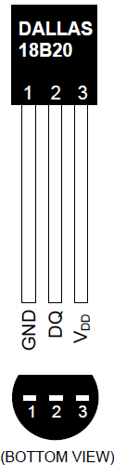
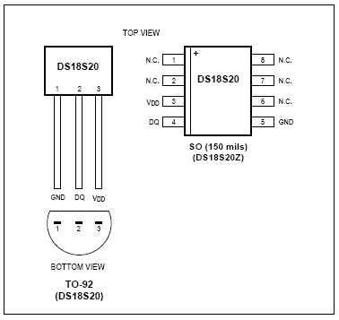
Wire Digital Thermometer (DS18B20)
of the DS18S20, and pin descriptions are given in the Pin Description table. The 64-bit ROM stores the device’s unique serial code. The scratchpad memory contains the 2-byte temperature register that stores the digital output from the temperature sensor.

Slide 17
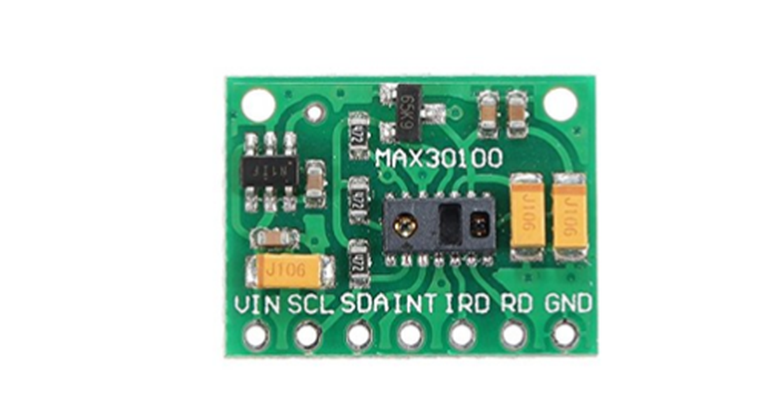
MAX30100 Pulse Oximeter:
The sensor is an integrated pulse oximetry and heart-rate monitor sensor solution. It combines two LED’s, a photo detector, optimized optics, and low-noise analog signal processing to detect pulse and heart-rate signals. It operates from 1.8V and 3.3V power supplies and can be powered down through software with negligible standby current, permitting the power supply to remain connected at all times.

Slide 18
WORKING OF THE SYSTEM

➢ There are mainly two parts of the system one is transmitter
and the other one is the receiver.
➢  In the transmitter, We have Heartbeat sensor, Spo2 and the temperature sensor.
➢ All the sensors are connected to the patient
➢  The Arduino monitors the all the system in the transmitter if any abnormality in the patient condition then it sends the signal so that the receiver will capture the signal and will work according to that.

Slide 19
ADVANTAGES OF PROPOSED METHOD
➢ Bridging the gap between the doctor and the patients.
➢ Best to be used on rural areas.
➢ It is a multipurpose so that overall conditions are easily
measured.
➢ Easy to operate.
➢ Compare with compact sensor it gives better performance.

Slide 20
FUTURE SCOPE
➢ Multiple parameters like Blood pressure, retinal size, age
and weight can be included as controlling parameters in the future.
➢ This system also developed by using advanced GSM and
GPRS technology in future.

Slide 21
CONCLUSION
➢ Portable and easy to use.
➢ Prevention is better than cure.
➢ Modern technologies have developed that promotes
comfortable and better life which is disease free.

Slide 22

THANK
YOU

